Slide 1
Introduction to CSS
Course Code: CSC 3215
Course Title: Web Technologies
Dept. of Computer Science
Faculty of Science and Technology
Lecturer No: | 09 | Week No: | 09 | Semester:
Lecturer: | Sazzad Hossain sazzad@aiub.edu

Slide 2
Lecture Outline
CSS Border
CSS Margin
CSS Padding
CSS Height Width

Slide 3
CSS Borders
The CSS border properties allow you to specify the style, width, and color of an element's border.
The border-style property specifies what kind of border to display.
The border-width property specifies the width of the four borders.
The border-color property is used to set the color of the four borders.

Slide 4
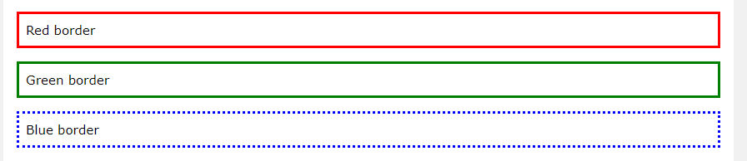
Example
p.one {
border-style: solid;
border-color: red;
}
p.two {
border-style: solid;
border-color: green;
}
p.three {
border-style: dotted;
border-color: blue;
}
Output:

Slide 5
Explanation
it is also possible to specify all the individual border properties in one property.
The border property is a shorthand property for the following individual border properties:
border-width
border-style (required)
border-color
Example
p { border: 5px solid red; }
Left Border
p { border-left: 6px solid red; background-color: lightgrey; }

Slide 6
CSS Margins
The CSS margin properties are used to create space around elements, outside of any defined borders.
There are properties for setting the margin for each side of an element (top, right, bottom, and left).
margin-top
margin-right
margin-bottom
margin-left
All the margin properties can have the following values:
auto - the browser calculates the margin
length - specifies a margin in px, pt, cm, etc.
% - specifies a margin in % of the width of the containing element
inherit - specifies that the margin should be inherited from the parent element

Slide 7
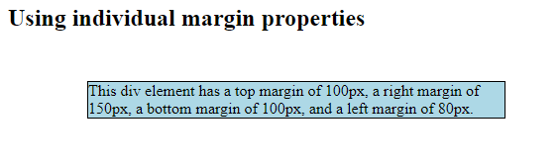
Example
div {
border: 1px solid black;
margin-top: 50px;
margin-bottom: 100px;
margin-right: 150px;
margin-left: 80px;
background-color: lightblue;
}

Slide 8
CSS Padding
padding properties are used to generate space around an element's content.
setting the padding for each side of an element (top, right, bottom, and left).
CSS has properties for specifying the padding for each side of an element:
padding-top
padding-right
padding-bottom
padding-left
All the padding properties can have the following values:
length - specifies a padding in px, pt, cm, etc.
% - specifies a padding in % of the width of the containing element
inherit - specifies that the padding should be inherited from the parent element

Slide 9
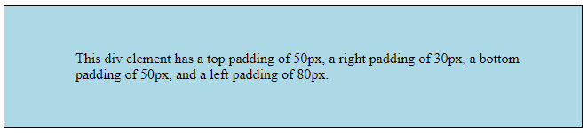
Example
div {
border: 1px solid black;
background-color: lightblue;
padding-top: 50px;
padding-right: 30px;
padding-bottom: 50px;
padding-left: 80px;
}

Slide 10
CSS Height and Width
The height and width properties are used to set the height and width of an element.
The height and width properties do not include padding, borders, or margins. It sets the height/width of the area inside the padding, border, and margin of the element.
The height and width properties may have the following values:
auto - This is default. The browser calculates the height and width
length - Defines the height/width in px, cm etc.
% - Defines the height/width in percent of the containing block
initial - Sets the height/width to its default value
inherit - The height/width will be inherited from its parent value

Slide 11
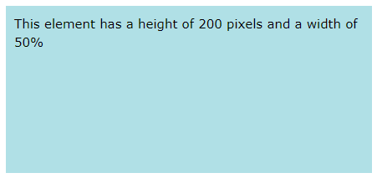
External CSS
div { height: 200px; width: 50%; background-color: powderblue; }

Slide 12
External CSS
An external style sheet can be written with a .css extension.
The external .css file should not contain any HTML tags.
"mystyle.css“
body { background-color: lightblue; } h1 { color: navy; margin-left: 20px; }

Slide 13
References
MySQL - www.mysql.com
W3Schools Online Web Tutorials- www.w3schools.com
PHP Manual - www.php.net

Slide 14
Books
Sams Teach Yourself Ajax JavaScript and PHP All in One; Phil Ballard and Michael Moncur;
Sams Publishing; 2010
JavaScript Phrasebook; Christian Wenz; Sams Publishing; 2007
PHP and MySQL Web Development, 4/E; Luke Welling and Laura Thomson; AddisonWesley Professional; 2009
JavaScript for Programmers Paul J. Deitel and Harvey M. Deitel; Prentice Hall; 2009

